Slide 1

Automation of Command Center Reports
By Rahul Kamble

Slide 2
TOPICS OF THE
PRESENTATION
Introduction
Exisiting Process (Problem Statement)
Proposed Solution
Conclusion

Slide 3
Introduction:
For Client: Bristol Myers Squibb, Project: BMS Pluto, Team: Pluto Command Center
Currently at Command Center we perform Incident Management as well as Major Incident Management. In Incident Management our day-to-day responsibilities include 24x7 monitoring of alerts, ticket SLAs and reporting.
Problem Statement:
We send out more than 10 reports daily, most of which are repetitive in nature. The reports sent out require manual effort of copy pasting and formatting.
This method is prone to manual errors.
This method is time consuming due to the efforts taken.
Great amount of text editing is done while working with e-mails and Excel sheets.

Slide 4
Proposed Solution:
Report generator is a work in progress GUI tool developed using Python scripting language. It aims to overcome the above mentioned problems.
Using this tool I aim to generate Command Center reports at the click of a button.
Currently the SMO reports are working in full capacity while other internal reports in functioning capacity.
This tool requires an input Excel/.csv file containing ticket details that can be obtained from Service Now portal and then selected through a file dialog.
Efforts Reduced: For “Daily Hygiene Reports”
Approx. time taken manually: Minimum- 30 mins (3-4 reports)
Approx. time taken by tool: 50 seconds for 1 report
Resources Reduced:
As an attended automation system the resource reduction hasn’t been estimated
MIM (Major Incident Management) is something that requires human effort and cannot be automated. This tool is aimed to enhance Incident Management process & make employees focus on MIM.

Slide 5
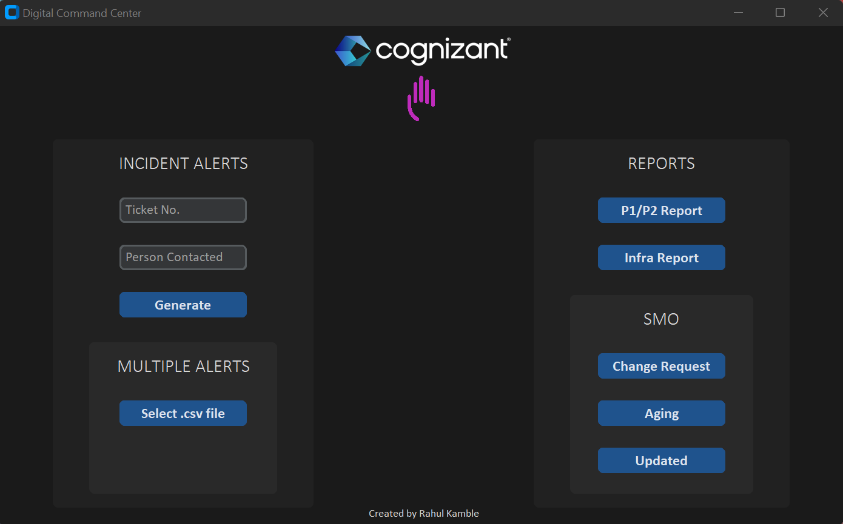

Slide 6
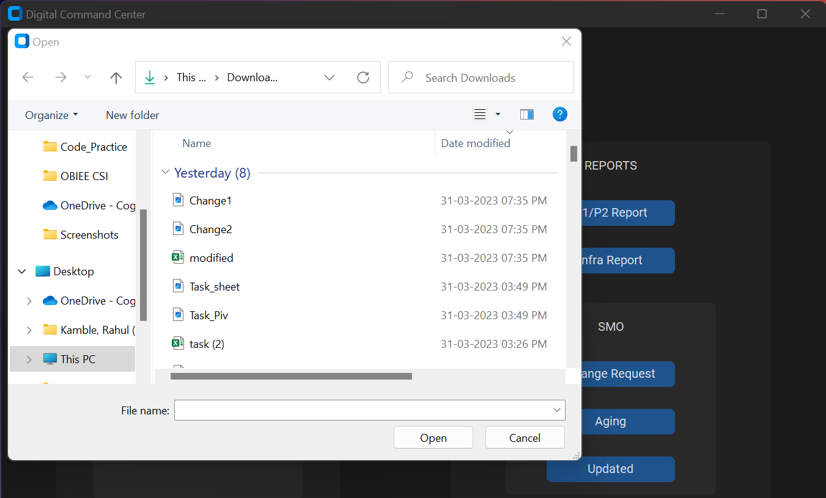

Slide 7
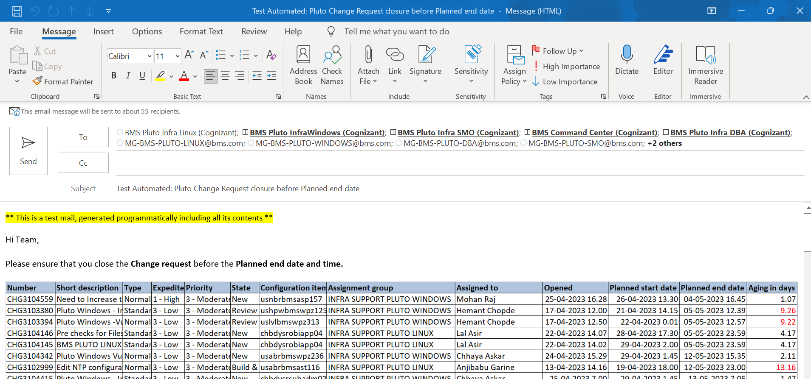

Slide 8
SOFTWARE SELECTION & DEPLOYMENT:
Language: Python
Version: 3.10.1
This GUI tool is aimed to be deployed as an executable file on respective member’s systems so there won’t be the need to download Python on their machines.

Slide 9
SCOPE OF THE SOLUTION:
This tool is in progress, it now needs access to Service NOW to get the ticket details programmatically.
With this tool we’ll be able to digitalize Command Center operations.
This will help associates focus more on the Major Incident Management part which requires human attention and communication skills.
It will improve the speed and accuracy of the reports.
This tool will particularly prove to be useful when there’s minimal staffing in the team.
A GUI tool is easy to operate for everyone.

Slide 10
Thank you

